Slide 1
SMART QUESTION
Huynh Anh Tu

Slide 2

01. What is smart question? 02. Why are smart question important? 03. When to ask smart question? 04. How to apply it on my daily basis/work?
SMART QUESTION

Slide 3
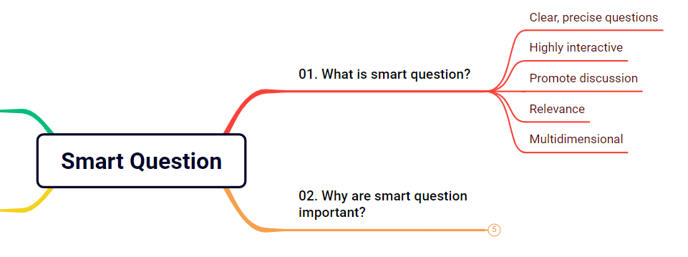
01. What is smart question ?

Slide 4

01. What is smart question ?
Smart questions are questions that are asked in a clear, accurate, and interactive way. This helps the respondent understand the question clearly and provides accurate and helpful answers to the questioner.

Slide 5
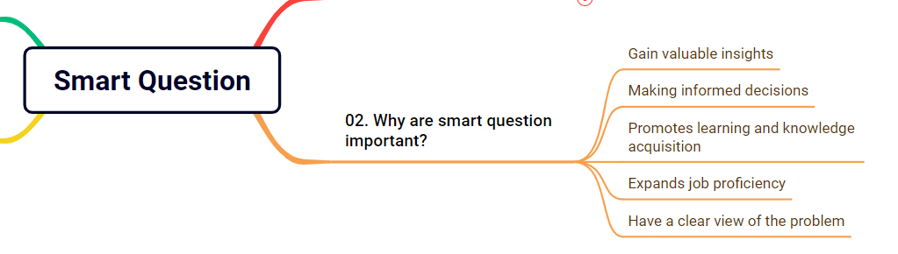
02. Why are smart question important?

Slide 6
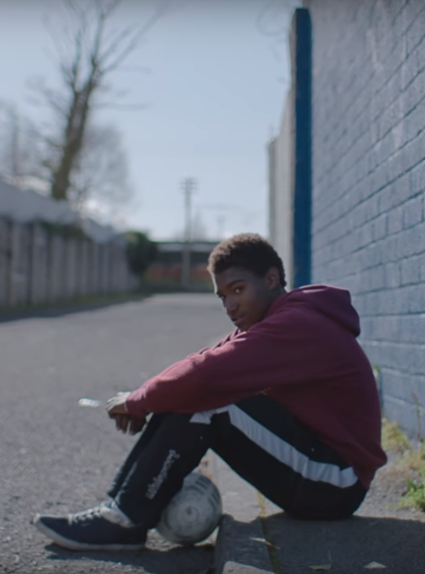
02. Why are smart question important?
Things we're going to get:
Gain valuable insights
Making informed decisions
Promotes learning and knowledge acquisition
Expands job proficiency
Have a clear view of the problem

Slide 7
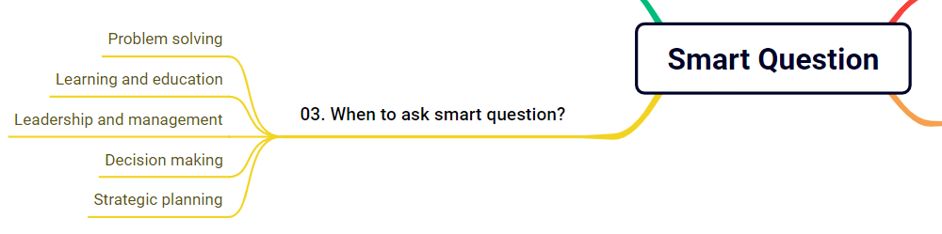
03. When to ask smart question?

Slide 8
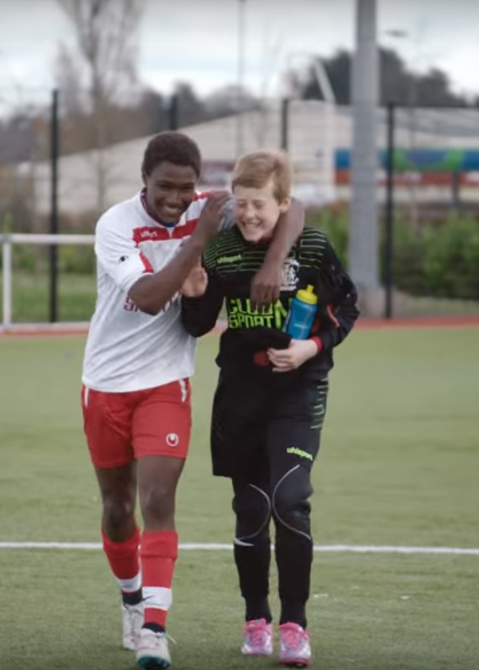
03. When to ask smart question?
Problem solving: Find ways to ask smart questions to solve problems.
Learning and education: Ask smart questions to acquire more knowledge.
Leadership and management: Ask smart questions to persuade employees.
Decision making: Ask smart questions to ensure the right decisions are made
Strategic planning: Ask smart questions to analyze a clear plan.

Slide 9
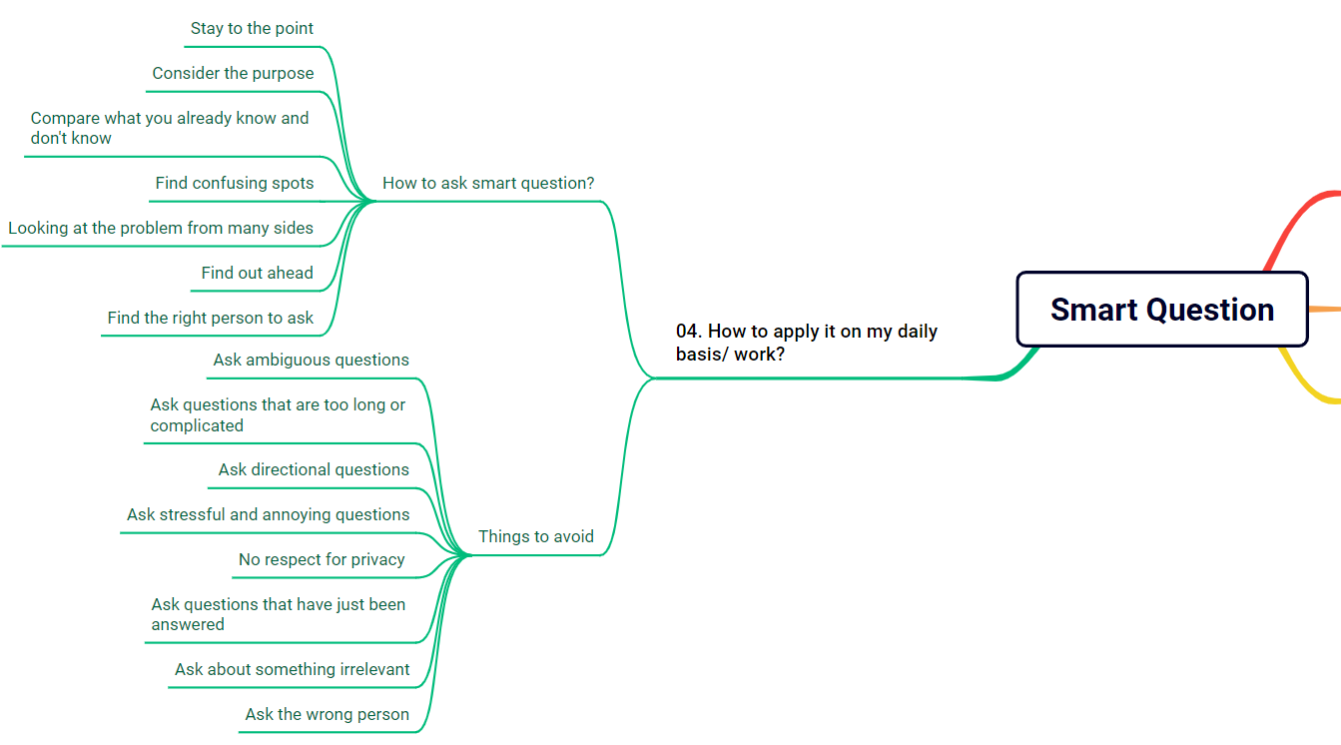
04. How to apply it on my daily basis/work?

Slide 10

How to ask smart question?
Stay to the point: Have just enough information to ask and know about what you are about to say
Consider the purpose: What will the answer help you achieve?
Compare what you already know and don't know: Do you have a lot of information, or just some small details?
Find confusing spots: Are you sure what you already know?
Looking at the problem from many side: Your question can be answered by looking at the problem from different directions.
Find out ahead: Do your own research before asking others.
Find the right person to ask: Make sure you've asked the right person.

Slide 11

Things to avoid !
Ask ambiguous questions
Ask questions that are too long or complicated
Ask directional questions
Ask stressful and annoying questions
No respect for privacy
Ask questions that have just been answered
Ask about something irrelevant
Ask the wrong person

Slide 12
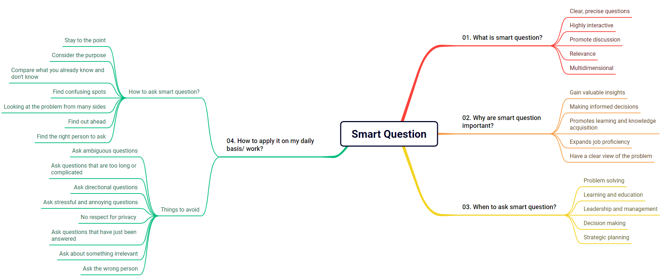
SUMMARY

Slide 13
THANKS!
Have a nice day!
Huynh Anh Tu
Phone: +84 929455098
Email: anhtu18042004@gmail.com

